Slide 1

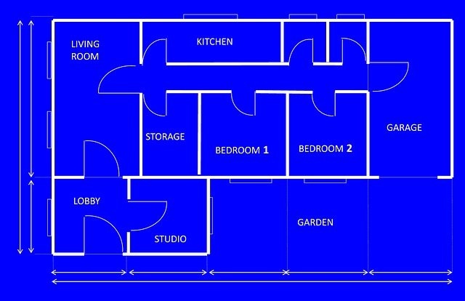


Data Structuring
By Billy Fryer
Part 2 of USOPC Data Analytics Fellow Project
Looks like a plan to me!

Slide 2
Raw Data is Messy
What We Start With
The Ideal Data Base

Slide 3

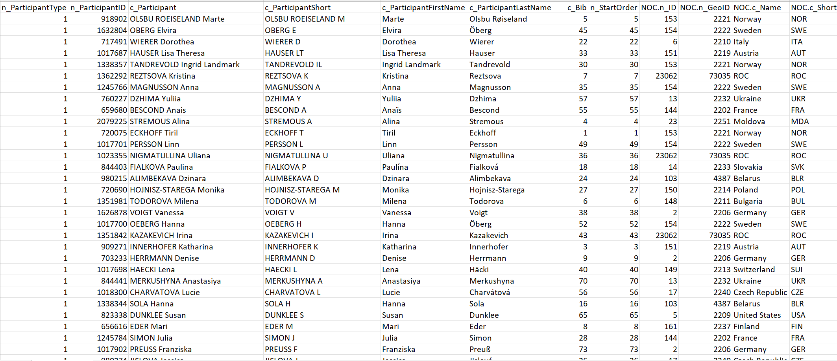
Raw Data is Messy
And that’s before the Data Analyst has the chance to mess anything up

Slide 4
What are some ways that we can structure data to make it a little less messy?

Slide 5


Key
Variables
Consistent
Naming

Slide 6
Key Variables
Key Variables are variables that are common across data sets
Ex: National Olympic Committee (NOC) Codes
Countries
Score
NOC Code | Country Name
USA | United States of America
IRI | Iran
NOC Code | Score
USA | 2
IRI | 1
NOC Code is in Both!

Slide 7


Key Variables
Key Variables must be unique
AUS
Austria
AUS
Australia
Austria
AUT
Australia
AUS

Slide 8
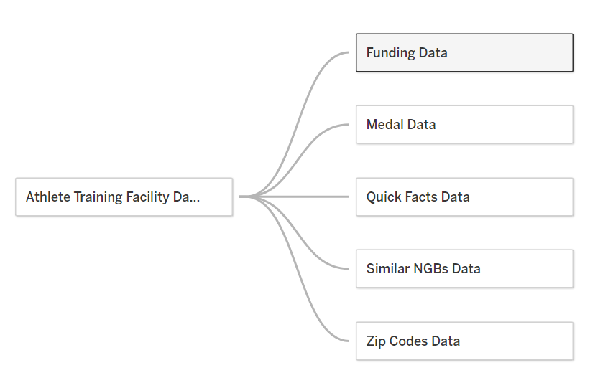
Key Variables in My Project
My data sets were all connected by the NGB key variable so that I could filter on my dashboard

Slide 9

Consistent Naming
USA
United States
United States of America
US
US of A
America
U.S.A.
U.S.
…
What country is this?

Slide 10
Whatever name we pick, it needs to be the same

Slide 11
Consistent Naming in Coding
There are naming rules that in coding too!
Column Names:
camelCase
snake_case
File Names:
with_underscores
with-hyphens

Slide 12

Takeaways
Team USA
Key
Variables
Raw Data is Messy
Consistent
Naming

